Slide 1
MediVison AI
AI-Powered Skin and Oral Disease Detection System
Developed by: Akhil Mohan

Slide 2
CONTENTS
Introduction
Problem Statement
Objectives
Literature Survey
Inferences from Literature Survey
Proposed System
Architecture Diagram
Novelty of Proposed Method
Algorithm / Workflow
Training Model
Dataset Details
Implementation
Key Features
Screenshots / Workflow
Hardware & Software Requirements
Performance Evaluation
Summary
Conclusion
Future Enhancements
References

Slide 3
INTRODUCTION
Healthcare accessibility and early disease detection are important challenges in modern society.
MediVision AI is an AI-powered healthcare web application developed to assist users in detecting skin and oral diseases using image analysis and symptom-based prediction.
The system integrates:
• Artificial Intelligence
• Deep Learning
• Web Technologies
• Symptom Analysis
to provide preliminary healthcare assistance.

Slide 4
PROBLEM STATEMENT
Traditional disease diagnosis often requires specialist consultation and manual examination, which may not always be immediately accessible.
Challenges:
• Delayed diagnosis
• Limited accessibility to healthcare specialists
• Lack of preliminary healthcare tools
• Time-consuming manual analysis
There is a need for an intelligent AI-assisted healthcare platform capable of providing preliminary disease prediction using medical images and symptoms.

Slide 5
OBJECTIVES
• Develop an AI-powered healthcare web application
• Detect skin diseases using image classification
• Detect oral diseases using image analysis
• Integrate symptom-based prediction system
• Maintain prediction history and user profiles
• Build responsive and user-friendly interface
• Integrate deep learning models with Flask backend

Slide 6
LITERATURE SURVEY
Existing Research Works:
1. Skin Disease Detection using CNN
- CNN-based medical image classification
- High accuracy for skin disease detection
2. Oral Disease Classification using Transfer Learning
- MobileNetV2 and deep learning models
- Faster disease prediction
3. AI-Based Healthcare Platforms
- Integration of AI and web applications
- Improved healthcare accessibility
Limitations of Existing Systems:
• Focus only on single disease category
• Limited user interaction
• Lack of symptom integration
• No history tracking

Slide 7
INFERENCE FROM LITERATURE SURVEY
From the literature survey, the following observations were identified:
• Most systems focus only on skin OR oral disease detection individually
• Existing systems lack integrated healthcare functionality
• Many systems do not include symptom-based prediction
• User authentication and prediction history are often missing
• Lightweight transfer learning models are more efficient for deployment
These observations motivated the development of MediVision AI.

Slide 8
PROPOSED SYSTEM
MediVision AI is designed as a complete AI-assisted healthcare platform.
Main Components:
• Flask Web Application
• TensorFlow AI Models
• SQLite Database
• Symptom Analysis Engine
• User Authentication System
The system allows users to:
• Upload images
• Enter symptoms
• Get AI-based disease prediction
• View confidence score
• Save prediction history

Slide 9
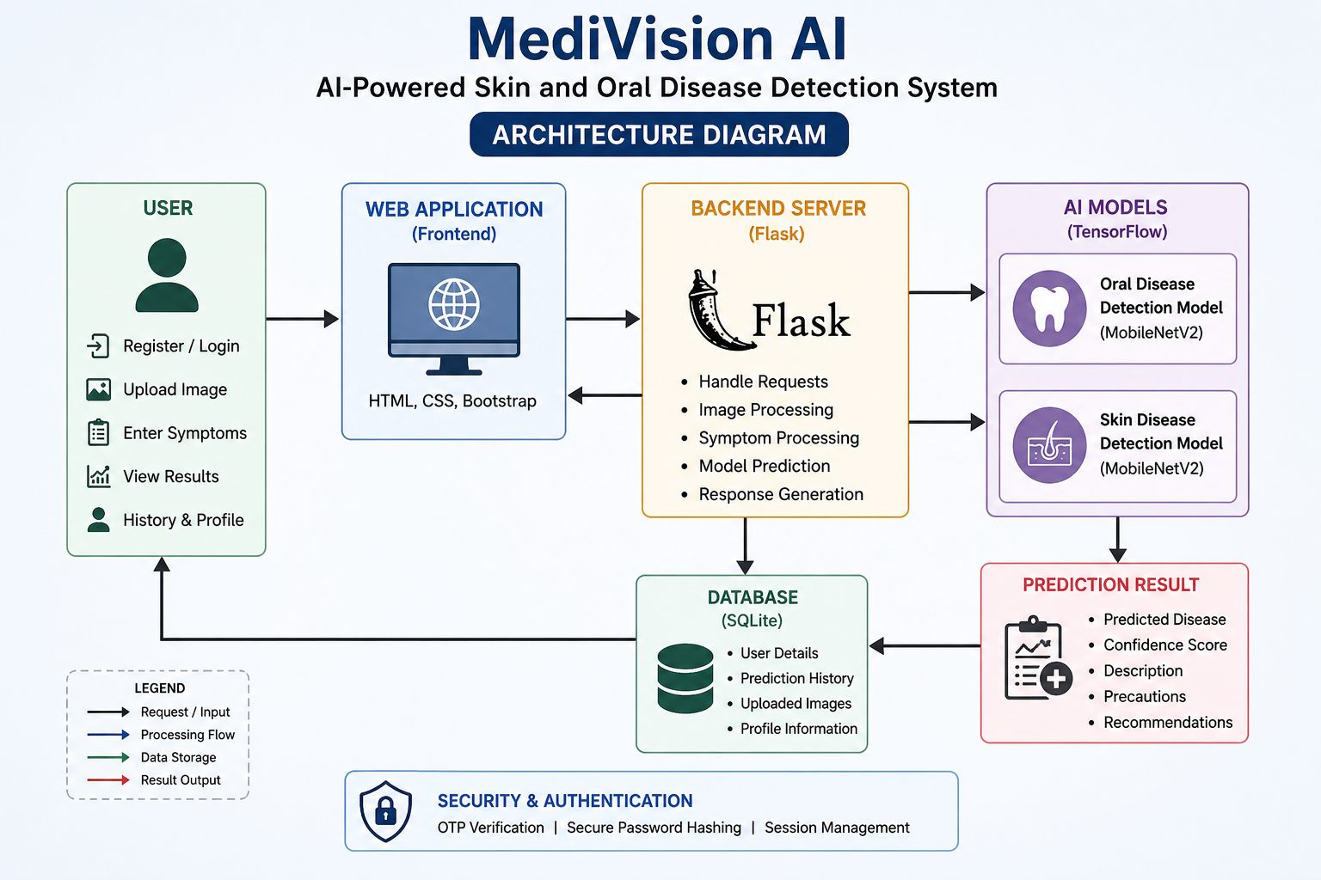
ARCHITECTURE DIAGRAM

Slide 10
NOVELTY OF SYSTEM
• Combined Skin + Oral Disease Detection
• Hybrid Image and Symptom Analysis
• AI Confidence Score Prediction
• OTP-Based User Authentication
• Prediction History Tracking
• Profile Management System
• Deep Learning Integration with Flask

Slide 11
WORKFLOW
1. User Login / Registration
2. Upload Skin or Oral Image
3. Enter Symptoms
4. Image Preprocessing
5. AI Model Prediction
6. Symptom Analysis
7. Generate Final Prediction
8. Store Prediction in Database
9. Display Result to User

Slide 12
TRAINING MODEL
AI Model Development:
• TensorFlow and Keras Framework
• MobileNetV2 Transfer Learning Architecture
• CNN-Based Classification Models
Training Parameters:
• Epochs: 10
• Batch Size: 32
• Image Size: 224x224
Benefits:
• Lightweight architecture
• Faster prediction
• Better deployment capability

Slide 13
DATASET DETAILS
Skin Disease Dataset:
• Source: Kaggle
• Multiple skin disease classes
• Includes Acne, Psoriasis, Vitiligo, Eczema, Warts, etc.
Dataset Link:
https://www.kaggle.com/datasets/pacificrm/skindiseasedataset
Oral Disease Dataset:
• Source: Kaggle
• Includes Gingivitis, Caries, Mouth Ulcer, Tooth Discoloration
Dataset Link:
https://www.kaggle.com/datasets/salmansajid05/oral-diseases

Slide 14
IMPLEMENTATION
Frontend:
• HTML
• CSS
• Bootstrap
Backend:
• Flask Framework
• Python
Database:
• SQLite
AI Integration:
• TensorFlow
• Keras
• MobileNetV2
Additional Features:
• OTP Verification
• Prediction History
• Profile Management

Slide 15
KEY FEATURES
• Skin Disease Detection
• Oral Disease Detection
• Symptom-Based Prediction
• AI Confidence Score
• User Authentication
• OTP Email Verification
• Prediction History
• User Profile Management
• Responsive UI Design

Slide 16
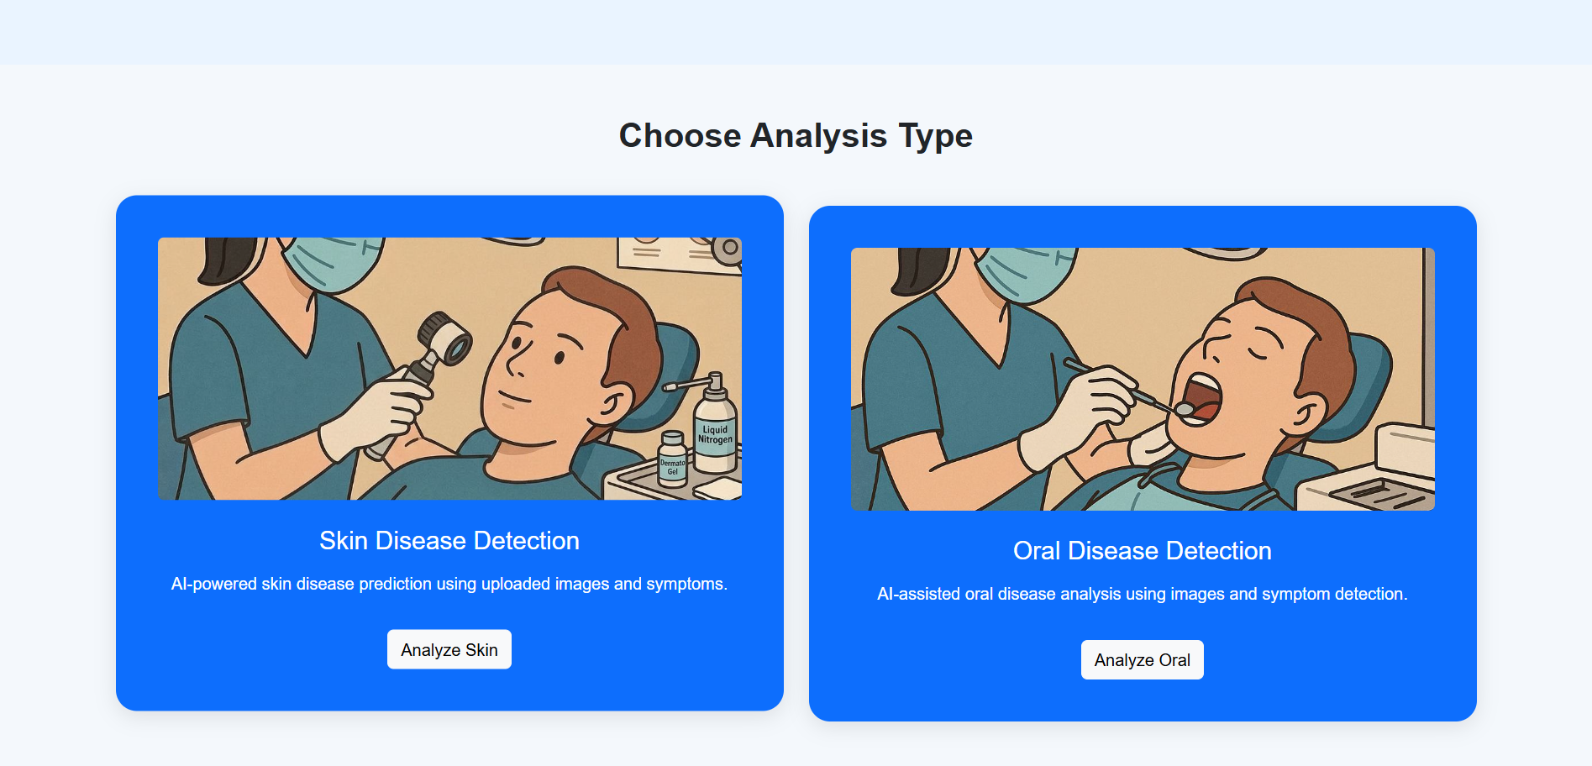
SCREENSHOTS

Slide 17
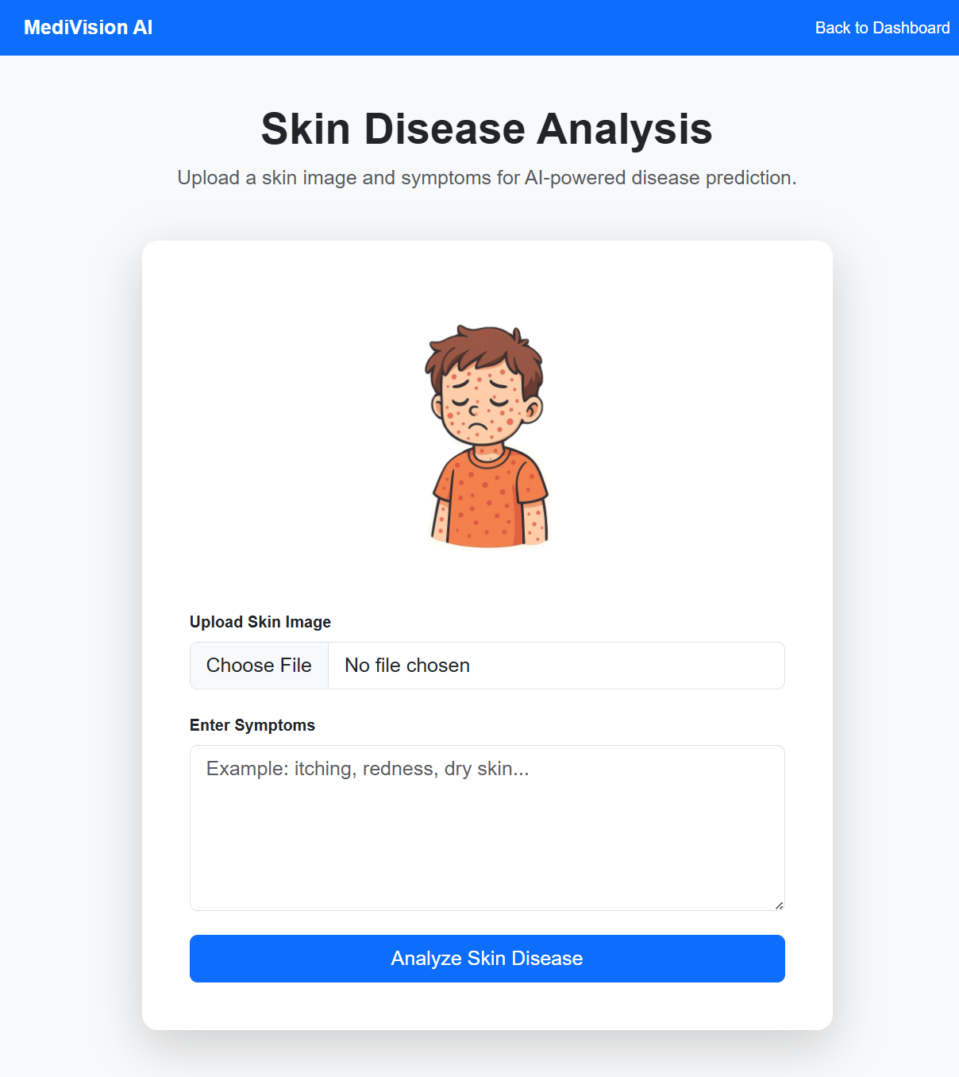

SCREENSHOTS

Slide 18
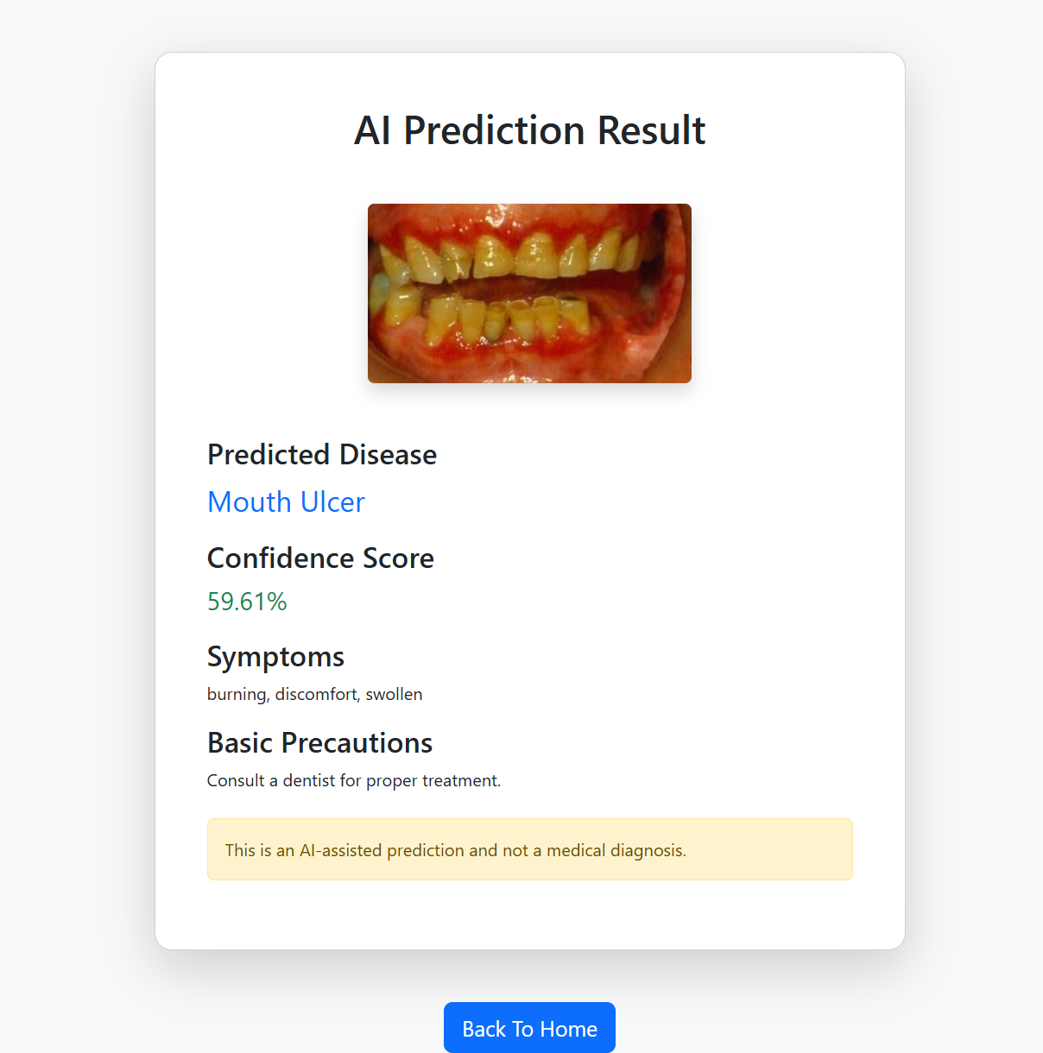
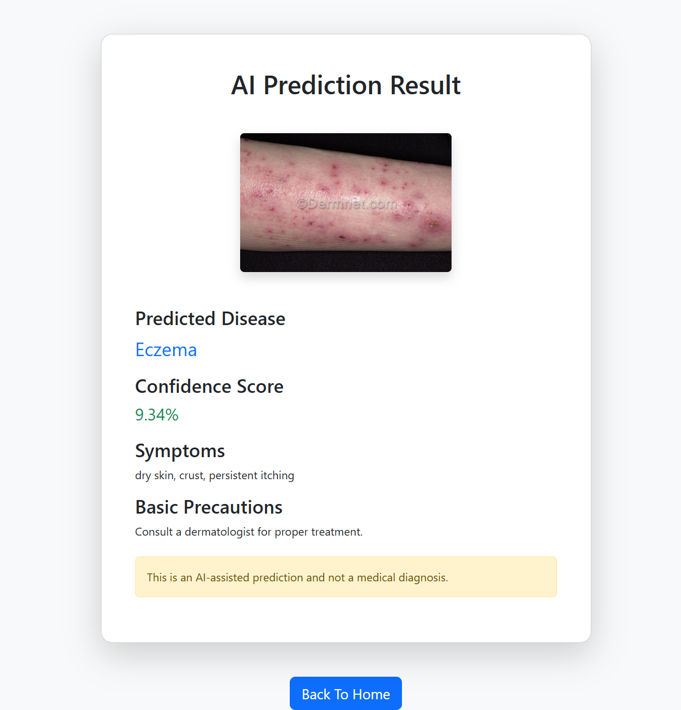
SCREENSHOTS

Slide 19
HARDWARE & SOFTWARE DETAILS
Hardware Requirements:
• Intel i5 Processor or Higher
• 8 GB RAM
• Internet Connection
Software Requirements:
• Python
• Flask
• TensorFlow
• SQLite
• VS Code
• Google Colab

Slide 20
PERFORMANCE EVALUATION
Oral Disease Model Accuracy:
48.15%
Skin Disease Model Accuracy:
23.60%
Performance Metrics:
• Accuracy
• Loss Analysis
• Confidence Score
The models can be improved further using:
• Larger datasets
• More epochs
• Better preprocessing
• Fine-tuning techniques

Slide 21
SUMMARY
MediVision AI successfully integrates:
• Artificial Intelligence
• Deep Learning
• Flask Web Development
• Symptom Analysis
• Database Management
into a complete AI-powered healthcare platform.

Slide 22
CONCLUSION
The project demonstrates the effectiveness of AI-assisted healthcare systems for preliminary disease prediction.
Achievements:
• Developed complete healthcare platform
• Integrated TensorFlow AI models
• Implemented symptom analysis
• Created responsive UI system
The system can assist users in obtaining preliminary healthcare insights efficiently.

Slide 23
FUTURE ENHANCEMENT
• Improve AI model accuracy
• Real-time camera prediction
• Cloud deployment
• AI chatbot integration
• Doctor consultation support
• PDF medical report generation
• Larger medical datasets

Slide 24
REFERENCES
[1] J. Rashid, M. A. Alhaisoni, S. H. Bukhari, et al., “Mouth and oral disease classification using InceptionResNetV2,” Multimedia Tools and Applications, vol. 83, pp. 1–28, 2024.
[2] M. Zhou, et al., “Deep learning algorithms for classification and detection of oral diseases,” Scientific Reports, vol. 14, no. 1, 2024.
[3] J. S. Velasco, J. V. Catipon, E. G. Monilar, et al., “Classification of Skin Disease Using Transfer Learning in Convolutional Neural Networks,” 2023 International Conference on Artificial Intelligence and Healthcare Systems, 2023.
[4] S. Innani, P. Dutande, B. Baheti, et al., “Deep Learning based Novel Cascaded Approach for Skin Lesion Analysis,” IEEE Access, vol. 11, pp. 21544–21558, 2023.
[5] A. G. Ali, A. Dastgir, M. W. Iqbal, et al., “A hybrid convolutional neural network model for automatic diabetic retinopathy classification from fundus images,” IEEE Journal of Translational Engineering in Health and Medicine, vol. 11, 2023.

